Slide 1
2
Application Development in Java

Slide 2
Objectives
Explain the structure of a Java class
List and explain steps to write a Java program
Identify the benefits of NetBeans IDE
Describe the various elements of NetBeans IDE
Explain the steps to develop, compile, and execute Java program using NetBeans IDE
Explain the various components of JVM
Describe comments in Java

Slide 3
Introduction 1-2
Java is a popular OOP language that supports developing applications for different requirements and domain areas.
All types of applications can be developed:
In a simple text editor, such as Notepad.
In an environment that provides necessary tools to develop a Java application.
The environment is called as Integrated Development Environment (IDE).

Slide 4
Introduction 2-2
Following figure shows the type of applications developed using Java
Java Applications
Console-based Application
Server-side Web Components
JavaBeans Component
Applets
Window-based Application
Enterprise Components

Slide 5
Structure of a Java Class 1-5
The Java programming language is designed around object-oriented features and begins with a class design.
The class represents a template for the objects created or instantiated by the Java runtime environment.
The definition of the class is written in a file and is saved with a .java extension.
Following figure shows the basic structure of a Java class.

Slide 6

Structure of a Java Class 2-5
package
Defines a namespace that stores classes with similar functionalities in them.
The package keyword identifies:
Name of the package to which the class belongs.
Visibility of the class within the package and outside the package.
The concept of package is similar to folder in the OS.
In Java, all classes belongs to a package. If the package statement is not specified, then the class belongs to the default package.
Example: All the user interface classes are grouped in the java.awt or java.swing packages.

Slide 7

Structure of a Java Class 3-5
import
Identifies the classes and packages that are used in a Java class.
Helps to narrow down the search performed by the Java compiler by informing it about the classes and packages.
Mandatory to import the required classes, before they are used in the Java program.
Some exceptions wherein the use of import statement is not required are as follows:
If classes are present in the java.lang package.
If classes are located in the same package.
If classes are declared and used along with their package name. For example, java.text.NumberFormat nf = new java.text. NumberFormat();

Slide 8


Structure of a Java Class 4-5
class
Variables
class keyword identifies a Java class.
Precedes the name of the class in the declaration.
public keyword indicates the access modifier that decides the visibility of the class.
Name of a class and file name should match.
Are also referred to as instance fields or instance variables.
Represent the state of objects.

Slide 9


Structure of a Java Class 5-5
Methods
Constructors
Are also methods or functions that are invoked during the creation of an object.
Are functions that represent some action to be performed on an object.
Are also referred to as instance methods.
Used to initialize the objects.

Slide 10
Developing a Java Program on Windows
Basic requirements to write a Java program are as follows:
The JDK 7 installed and configured on the system.
A text editor, such as Notepad.
To create, compile, and execute a Java program, perform the following steps:
Create a Java program
Compile .java file
Build and execute Java program

Slide 11
Create a Java Program 1-4
Following code snippet demonstrates a simple Java program:
class is a keyword and HelloWorld is the name of the class.
The entire class definition and its members must be written within the opening and closing curly braces {}.
The area between the braces is known as the class body and contains the code for that class.
public class HelloWorld { public static void main(String[] args) { System.out.println(“Welcome to the world of Java”); } }

Slide 12
Create a Java Program 2-4
Following code snippet demonstrates a simple Java program:
main()- method is the entry point for a java-based console application.
public - Is a keyword that enables the JVM to access the main() method.
static - Is a keyword that allows a method to be called from outside a class without creating an instance of the class.
void - Is a keyword that represents the data type of the value returned by the main() method. It informs the compiler that the method will not return any value.
args - Is an array of type String and stores command line arguments. String is a class in Java and stores group of characters.
public class HelloWorld { public static void main(String[] args) { System.out.println(“Welcome to the world of Java”); } }

Slide 13
Create a Java Program 3-4
Following code snippet demonstrates a simple Java program:
System.out.println() statement displays the string that is passed as an argument.
System is the predefined class and provides access to the system resources, such as console.
out is the output stream connected to the console.
println() is the built-in method of the output stream that is used to display a string.
public class HelloWorld { public static void main(String[] args) { System.out.println(“Welcome to the world of Java”); } }

Slide 14
Create a Java Program 4-4
Following code snippet demonstrates a simple Java program:
Save the file as HelloWorld.java.
The file name is same as class name, as the compilation of a Java code results in a class. Hence, the class name and the file name should be same.
public class HelloWorld { public static void main(String[] args) { System.out.println(“Welcome to the world of Java”); } }

Slide 15
Compile .java File 1-4
Following figure shows the compilation process of the Java program.
The HelloWorld.java file is known as source code file.
It is compiled by invoking tool named javac.exe, which compiles the source code into a .class file.
The .class file contains the bytecode which is interpreted by java.exe tool.
java.exe interprets the bytecode and runs the program.

Slide 16
Compile .java File 2-4
The syntax to use the javac.exe command:
where,
source - Is one or more file names that end with a .java extension.
Syntax
javac [option] source

Slide 17
Compile .java File 3-4
Following table lists some of the options that can be used with the javac command:
For example, javac -d c:\ HelloWorld.java will create and save HelloWorld.class file in the C:\ drive.
Option | Description
-classpath | Specifies the location for the imported classes (overrides the CLASSPATH environment variable)
-d | Specifies the destination directory for the generated class files
-g | Prints all debugging information instead of the default line number and file name
-verbose | Generates message while the class is being compiled
-version | Displays version information
Sourcepath | Specifies the location of the input source file
-help | Prints a synopsis of standard options

Slide 18
Compile .java File 4-4
To compile the HelloWorld.java program from the Windows platform, the user can:
Click Start menu.
Choose Run.
Enter the cmd command to display the Command Prompt window.
Following figure shows the Command Prompt window:
Set the drive and directory path to the directory containing .java file. For example, cd H:\Java.
Type the command, javac HelloWorld.java and press Enter.

Slide 19
Build and Execute Java Program 1-4
The JVM is at the heart of the Java programming language.
It is responsible for executing the .class file or bytecode file.
The .class file can be executed on any computer or device, that has the JVM implemented on it.
Following figure shows the components of JVM involved in the execution of the compiled bytecode.

Slide 20
Build and Execute Java Program 2-4
The class loader component of JVM loads all the necessary classes from the runtime libraries required for execution of the compiled bytecode.
The bytecode verifier then checks the code to ensure that it adheres to the JVM specification.
To boost the speed of execution, in Java version 2.0, a Hot Spot Just-in-Time (JIT) compiler was included at runtime.
The bytecode is executed by the interpreter.
During execution, the JIT compiler compiles some of the code into native code or platform-specific code to boosts the performance.

Slide 21
Build and Execute Java Program 3-4
The Java interpreter command, java is used to interpret and run the Java bytecode.
The syntax to use the java.exe command is as follows:
where,
classname: Is the name of the class file.
arguments: Is the arguments passed to the main function.
To execute the HelloWorld class, type the command, java HelloWorld and press Enter.
Syntax
java [option] classname [arguments]]

Slide 22
Build and Execute Java Program 4-4
Following table lists some of the options that can be used with the java command:
Option | Description
classpath | Specifies the location for the imported classes (overrides the CLASSPATH environment variable)
-v or –verbose | Produces additional output about each class loaded and each source file compiled
-version | Displays version information and exits
-jar | Uses a JAR file name instead of a class name
-help | Displays information about help and exits
-X | Displays information about non-standard options and exits

Slide 23
NetBeans IDE 1-7
It is an open-source integrated development environment written purely in Java.
It is a free and robust IDE that helps developers to create cross-platform desktop, Web, and mobile applications using Java.
It contains features such as code completions, code template, and fix import for faster development.
Some of its benefits are as follows:
Provides plug-in modules and supports rich client applications.
Provides graphical user interface for building, compiling, debugging, and packaging of applications.
Provides simple and user-friendly IDE configuration.

Slide 24
NetBeans IDE 2-7
The NetBeans IDE has the following elements and views:
Menu Bar
Folders View
Components View
Coding and Design View
Output View

Slide 25
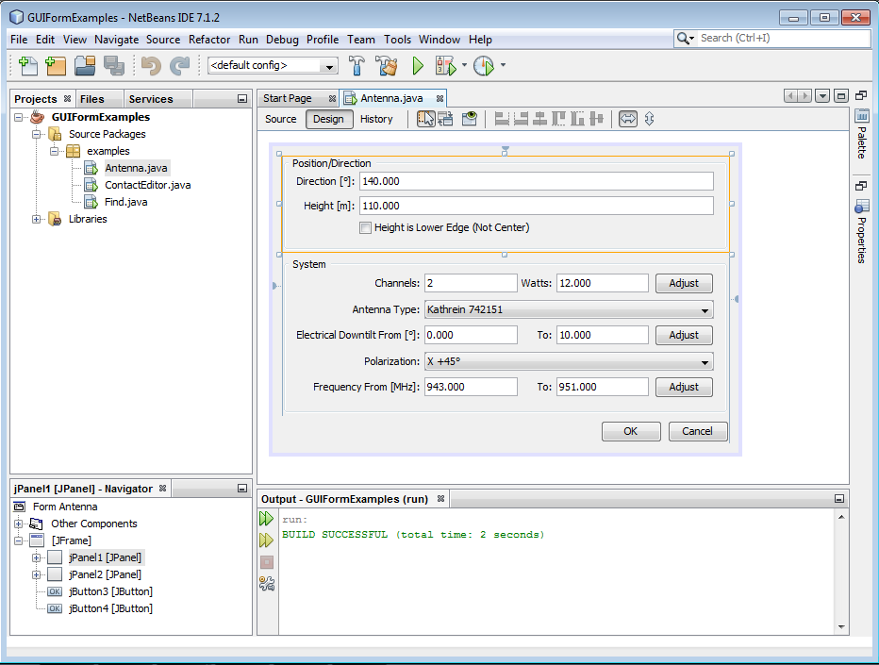
NetBeans IDE 3-7
Figure shows the various elements in the NetBeans IDE 7.1.2.
Menu bar of NetBeans IDE contains menus that have several sub-menu items, each providing a unique functionality.

Slide 26
NetBeans IDE 4-7
Folder view shows the structure of files associated with Java applications. It contains Projects window, Files window, and Services window.

Slide 27
NetBeans IDE 5-7
Component window is used for viewing components in the NetBeans IDE. It contains Navigator window that displays details of the source files of the currently opened project.

Slide 28
NetBeans IDE 6-7
Code and Design view contains two elements: Source Editor and Design Form. Source editor help to create and edit the code. Design window helps in design the form.

Slide 29
NetBeans IDE 7-7
Output window shows compilation errors, debugging messages, and the result of the program.

Slide 30
Download and Install NetBeans IDE 1-5
The latest version of NetBeans IDE for different platforms, such as Windows, Linux, Solaris, and Mac OS X is available for download at http://netbeans.org/downloads/index.html.
On the NetBeans IDE download Web page, you will find different installers.
Each installer of NetBeans IDE contains the basic IDE and its related tools.

Slide 31
Download and Install NetBeans IDE 2-5
The different installers are as follows:
Java SE - Supports all standard features that are necessary for Java SE development.
Java EE - Provides tools for developing Java SE and Java EE applications. This download option also includes GlassFish Server Open Source Edition and Apache Tomcat software.
C/C++ - Supports development in the C, C++, Fortran, and Assembly languages.
PHP - Provides tools for PHP 5.x development, Zend, and Symfony Framework support.
All - This is a full download option, which contains all the runtimes and technologies available for the NetBeans IDE.

Slide 32
Download and Install NetBeans IDE 3-5
To download the NetBeans IDE 7.1.2, perform the following steps:
Type http://netbeans.org/downloads/7.1.2/index.html in the Address bar of the Web browser .
Following figure shows the download Web page for the NetBeans 7.1.2 IDE:

Slide 33
Download and Install NetBeans IDE 4-5
Select IDE language as English from the drop-down list. Also, select the Platform as Windows from the drop-down list.
Click Download under the installer All. The Save As dialog box is opened with netbeans-7.1.2- ml-windows.exe installer file. This installer will support development of all technologies in the NetBeans IDE.
Click Save to save the installer file on the local system.
To install the NetBeans IDE, perform the following steps:
1
Double-click netbeans-7.1.2-ml-windows.exe to run the installer.
2
Click Next at the Welcome page of the installation wizard.
3
Click Next in the License Agreement page after reviewing the license agreement, and select the acceptance check box.

Slide 34
Download and Install NetBeans IDE 5-5
4
At the JUnit License Agreement page, decide if you want to install JUnit and click the appropriate option, click Next.
5
Select either the default installation directory or specific directory where the NetBeans IDE needs to be installed. Set the path of the default JDK installation and click Next.
6
The GlassFish Server Source Edition 3.1.2 installation page is displayed. You can either select the default location or specify another location to install the GlassFish Server.
7
8
9
To install the Apache Tomcat Server, on the installation page, either select the default location or specify another location and then, click Next.
The Summary page is opened. The list of components that are to be installed is displayed,
Click Install to install the NetBeans IDE on the system.
10
After the installation is completed, click Finish to complete and close the setup page.

Slide 35
Writing a Java Program Using NetBeans IDE
The basic requirements to write a Java program using the NetBeans IDE is as follows:
The JDK 7 installed and configured on the system
The NetBeans IDE
To develop a Java program in NetBeans IDE, perform the following steps:
Create a project in IDE
Build and execute Java program
Add code to the generated source files

Slide 36
Create a Project in IDE 1-2
To create a project in IDE, perform the following steps:
To launch NetBeans IDE, click Start→All Programs→NetBeans and select NetBeans IDE 7.1.2.
To create a new project, click File→New→Project. This opens the New Project wizard.
Under Categories, expand Java and then, select Java Application under Projects.
Click Next. This displays the Name and Location page in the wizard.
Type HelloMessageApp in the Project Name box.
Click Browse and select the appropriate location on the system.
Click Finish.

Slide 37
Create a Project in IDE 2-2
Following figure shows the HelloMessageApp project in the NetBeans IDE:

Slide 38
Add Code to the Generated Source Files
The necessary skeleton of the program has been created by the IDE.
Following figure shows the NetBeans IDE with the modified code:

Slide 39
Build and Execute Java Program in NetBeans IDE 1-2
To compile the source file, HelloMessageApp.java, click Run→Build Main Project in the NetBeans IDE menu bar.
Following figure shows Files window that shows the generated bytecode file, HelloMessageApp.class after the project is build successfully:

Slide 40
Build and Execute Java Program in NetBeans IDE 2-2
To execute the program, click Run→Run Main Project.
Following figure shows the Output window that displays the output of the HelloMessageApp program.

Slide 41
Comments in Java
Are placed in a Java program source file.
Are used to document the Java program and are not compiled by the compiler.
Are added as remarks to make the program more readable for the user.
Are of three types:
Single-line comments
Multi-line comments
Javadoc comments

Slide 42
Single-line Comments 1-2
A single-line comment is used to document the functionality of a single line of code.
There are two ways of using single-line comments that are as follows:
The syntax for applying the comments is as follows:
This type of comment can be placed before the code (on a different line).
End-of-line comment
This type of comment is placed at the end of the code (on the same line).
Beginning-of-line comment
Syntax
// Comment text

Slide 43
Single-line Comments 2-2
Following code snippet shows the different ways of using single-line comments in a Java program:
Conventions for using single-line comments are as follows:
Insert a space after the forward slashes.
Capitalize the first letter of the first word.
... // Declare a variable int a = 32; int b // Declare a variable ...

Slide 44
Multi-line Comments
Is a comment that spans multiple lines.
Starts with a forward slash and an asterisk (/*).
Ends with an asterisk and a forward slash (*/).
Anything that appears between these delimiters is considered to be a comment.
Following code snippet shows a Java program that uses multi-line comments:
... /* * This code performs mathematical * operation of adding two numbers. */ int a = 20; int b = 30; int c; c = a + b; ...

Slide 45
Javadoc Comments 1-2
Is used to document public or protected classes, attributes, and methods.
Starts with /** and ends with */.
Everything between the delimiters is a comment.
The javadoc command can be used for generating Javadoc comments.
Following code snippet demonstrates the use of Javadoc comments in the Java program:
/** * The program prints the welcome message * using the println() method. */ package hellomessageapp;

Slide 46
Javadoc Comments 2-2
/** * * @author vincent */ public class HelloMessageApp { /** * @param args the command line arguments */ public static void main(String[] args) { // The println() method displays a message on the screen System.out.println(“Welcome to the world of Java”); } }

Slide 47
Summary
The Java programming language is designed around object-oriented features and begins with a class design.
A Java class structure contains the following components namely, package, import, class name, variables, and methods.
Java programs can be written in a text editor, such as Notepad or in an IDE, such as NetBeans.
The entry point for a Java console application is the main() method.
The javac.exe compiles the source code into a .class file. Similarly, the java.exe command is used to interpret and run the Java bytecodes.
NetBeans is a free and robust IDE that helps developers to create cross-platform desktop, Web, and mobile applications using Java.
Comments are used to document the Java program and are not compiled by the compiler. There are three styles of comments supported by Java namely, single-line, multi-line, and Javadoc.

